Slide 1
5th Grade Lesson
Made by Kudinova Oxana
18ИА-о-21/2

Slide 2
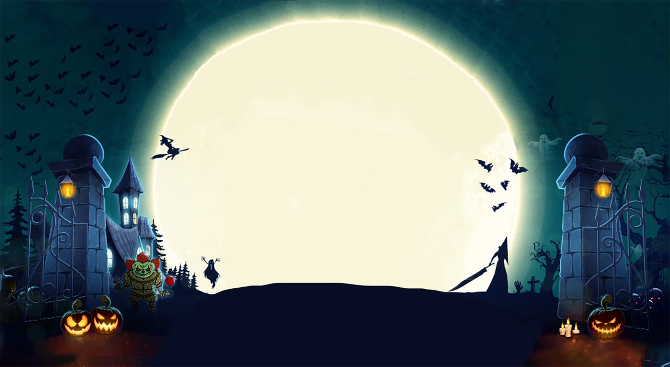
The topic of the lesson
When witches go riding,
And black cats are seen,
The moon laughs and whispers,
It’s near
Halloween

Slide 3
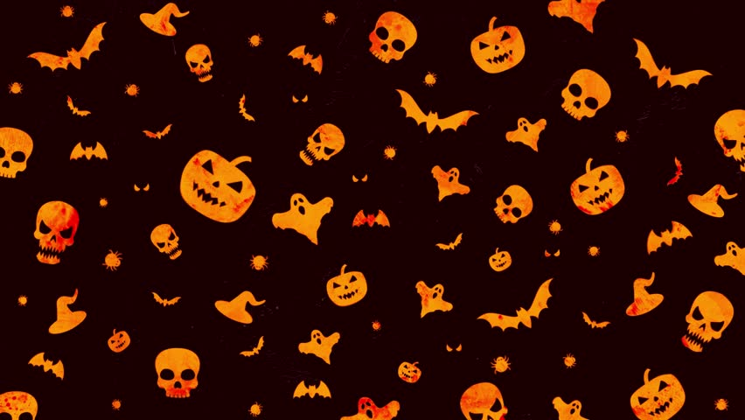
Before you watch

Slide 4

Answer the questions
What do you know about Halloween?
What are 3 adjectives that you can use for Halloween
Do you like this holiday?
Do you celebrate it?

Slide 5

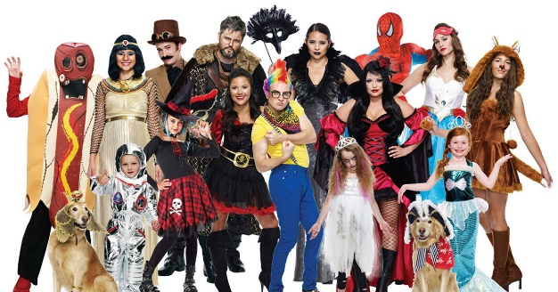
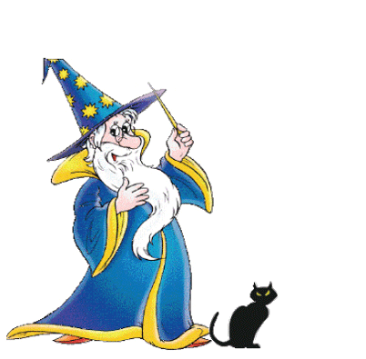
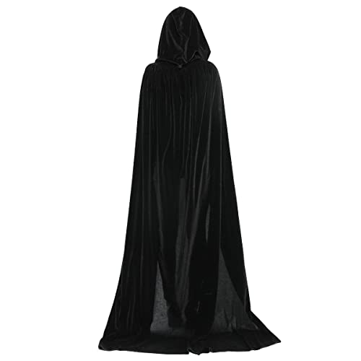


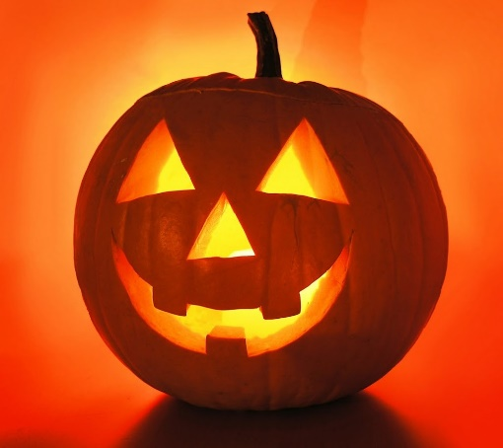
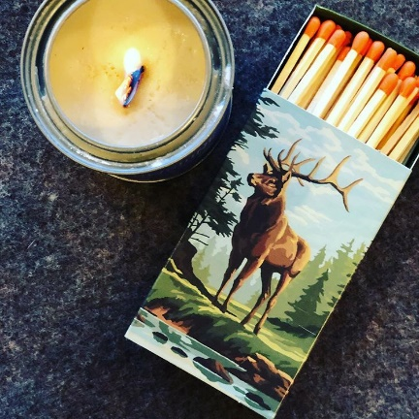
Match the words with the pictures
A pumpkin lantern
A candle and some matches
Fancy dress costumes
A black cloak
A wizard
A wizard’s hat
Scary

Slide 6
After watch

Slide 7
Watch the video and answer the fallowing questions
What are the boy’s and the girl’s names?
What is the video about?
When do people celebrate Halloween?
What did Jack put out the cupboard?
What do Jack and Sally wear for the Halloween party?
What is Sally making for the party?

Slide 8
Listening and watching for details

Slide 9
Fill in the gaps
Sally is making a …
Jack puts the … inside the …
Put it …
Jack is wearing a … … and … …
He is a …
Lack is making … pizzas for the party

Slide 10
Correct the mistakes
Sally found a black cloak
Sally is a fairy
She doesn’t want to wear the mask
They have few food for the party
Jack is going to be a zombie

Slide 11
After watching

Slide 12
Disscusion
Do you think all countries should celebrate Halloween?
Do you think Halloween is scary?
Have you ever dressed up as someone or something?
What do you think is the best costume for Halloween?

Slide 13

Hometask
Write about the best Halloween costume. Describe the entire process of creating it and the reactions of your friends.

Slide 14



How do you feel about the lesson
What was your favorite activity?
What was your least favorite activity?
What was hard?

