Slide 1
Make beliefs comix
Kudinova Oxana
21/2

Slide 2
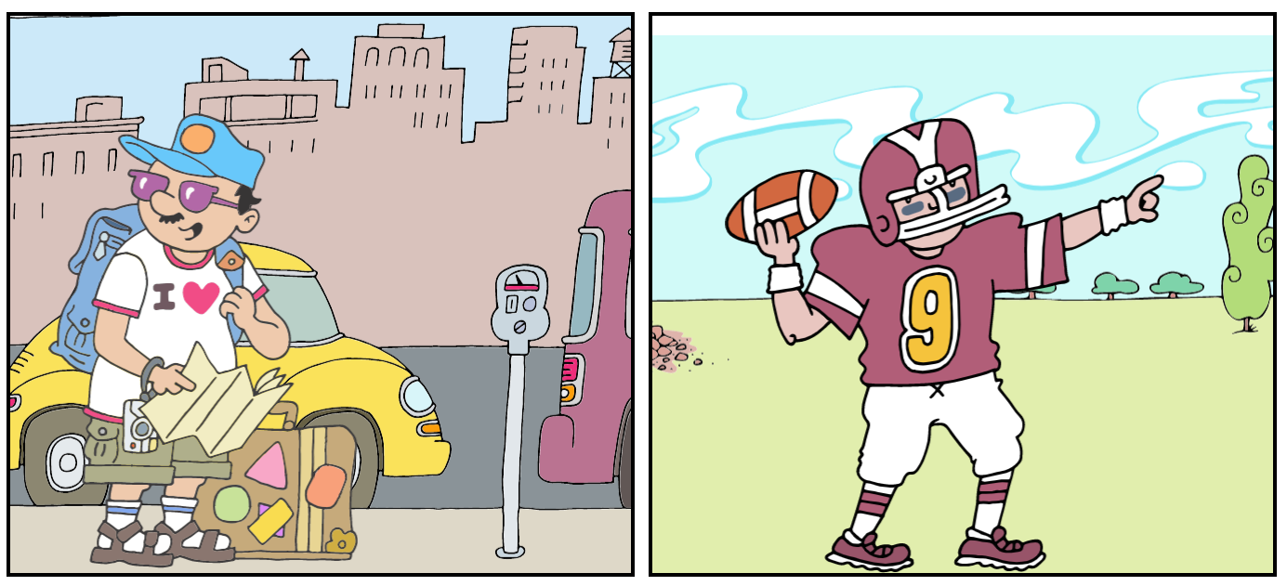
Study the two photographs. In 1.5 minutes be ready to compare and contrast the photographs:
• give a brief description of the photos (action, location)
• say what the pictures have in common
• say in what way the pictures are different
• say which of the concerts presented in the pictures you’d prefer
• explain why
You will speak for not more than 2 minutes (12–15 sentences). You have to talk continuously.

Slide 3
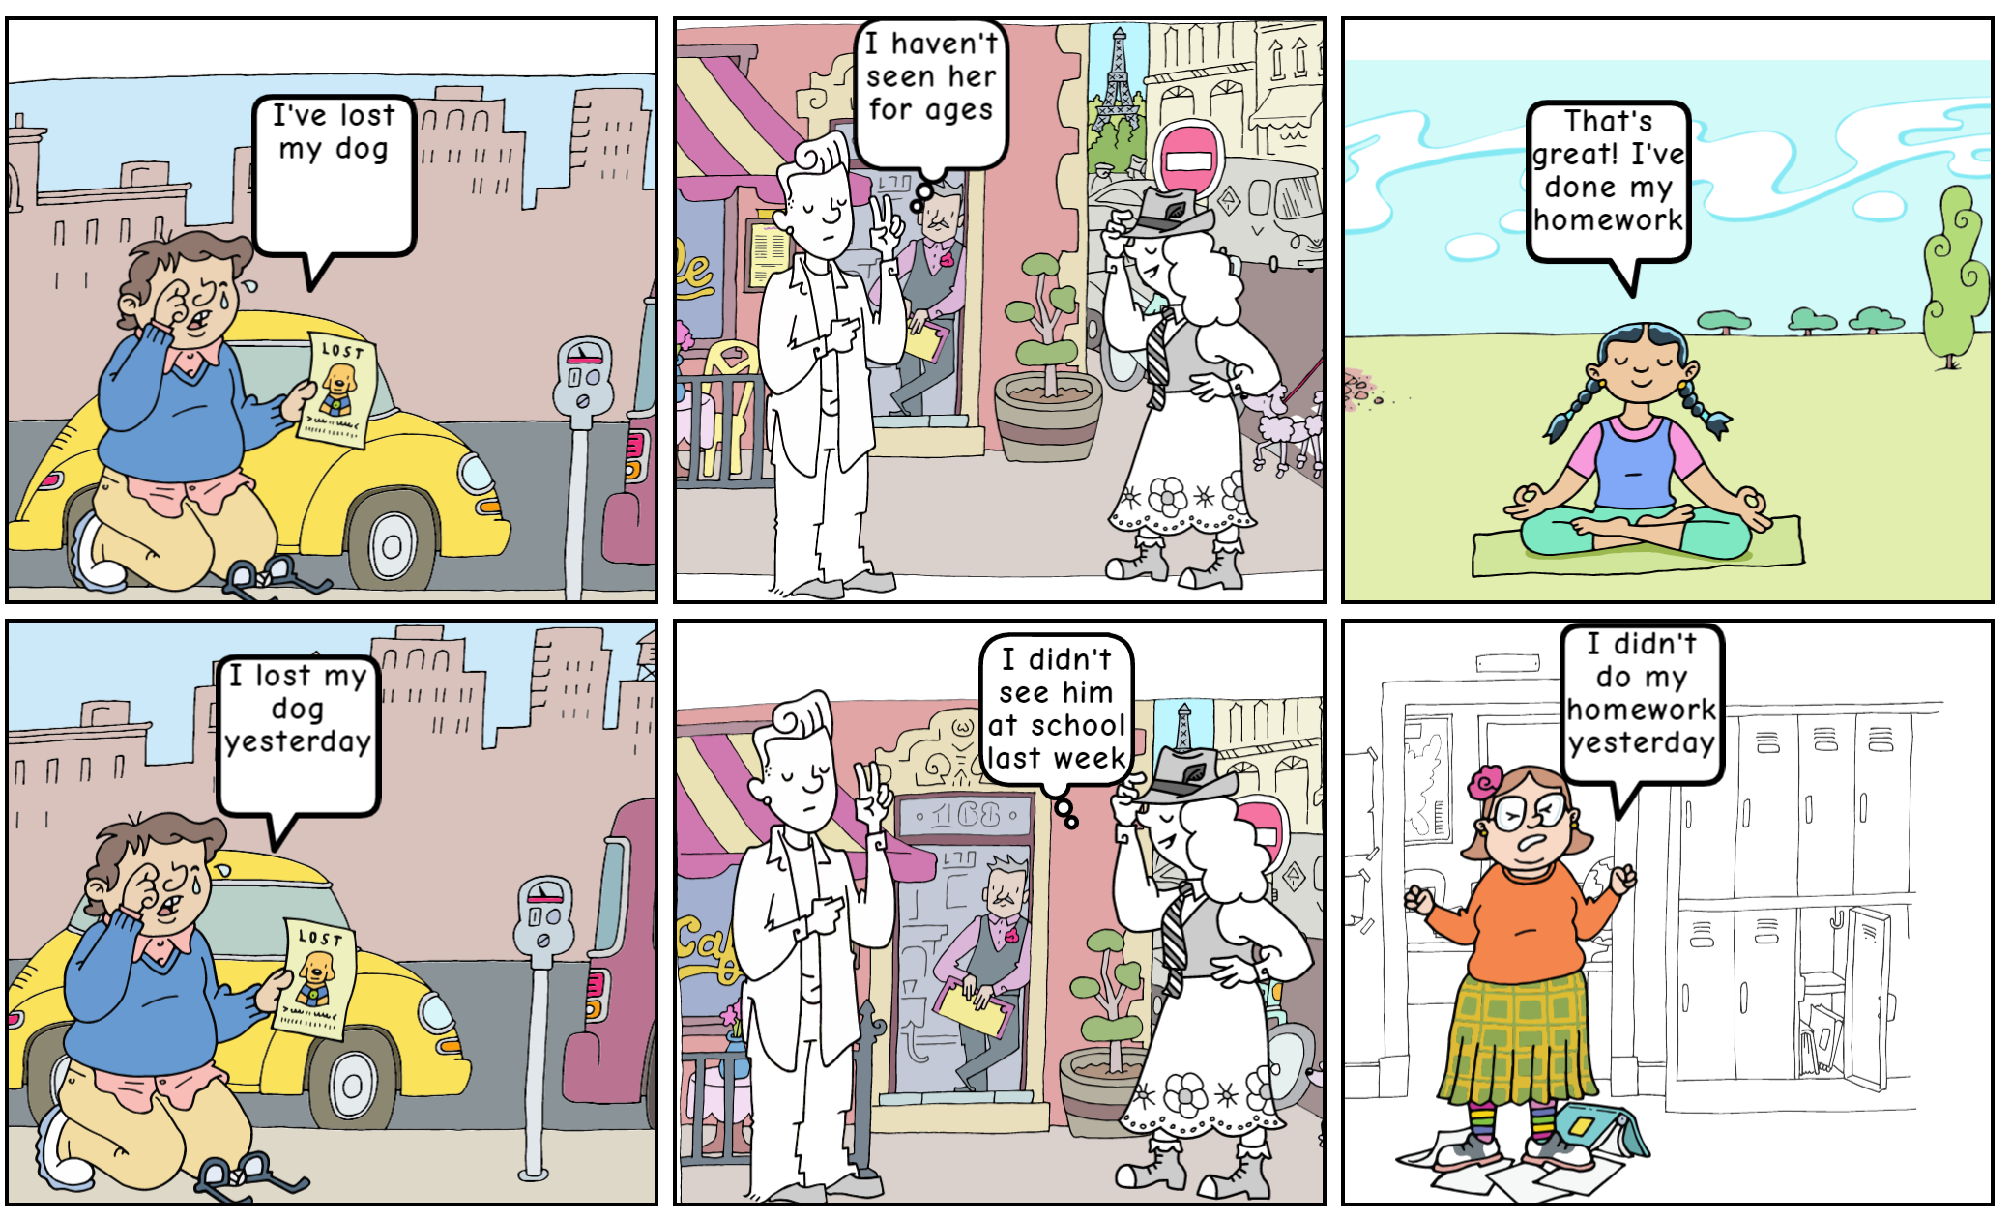
Present Perfect VS Past Simple

Slide 4
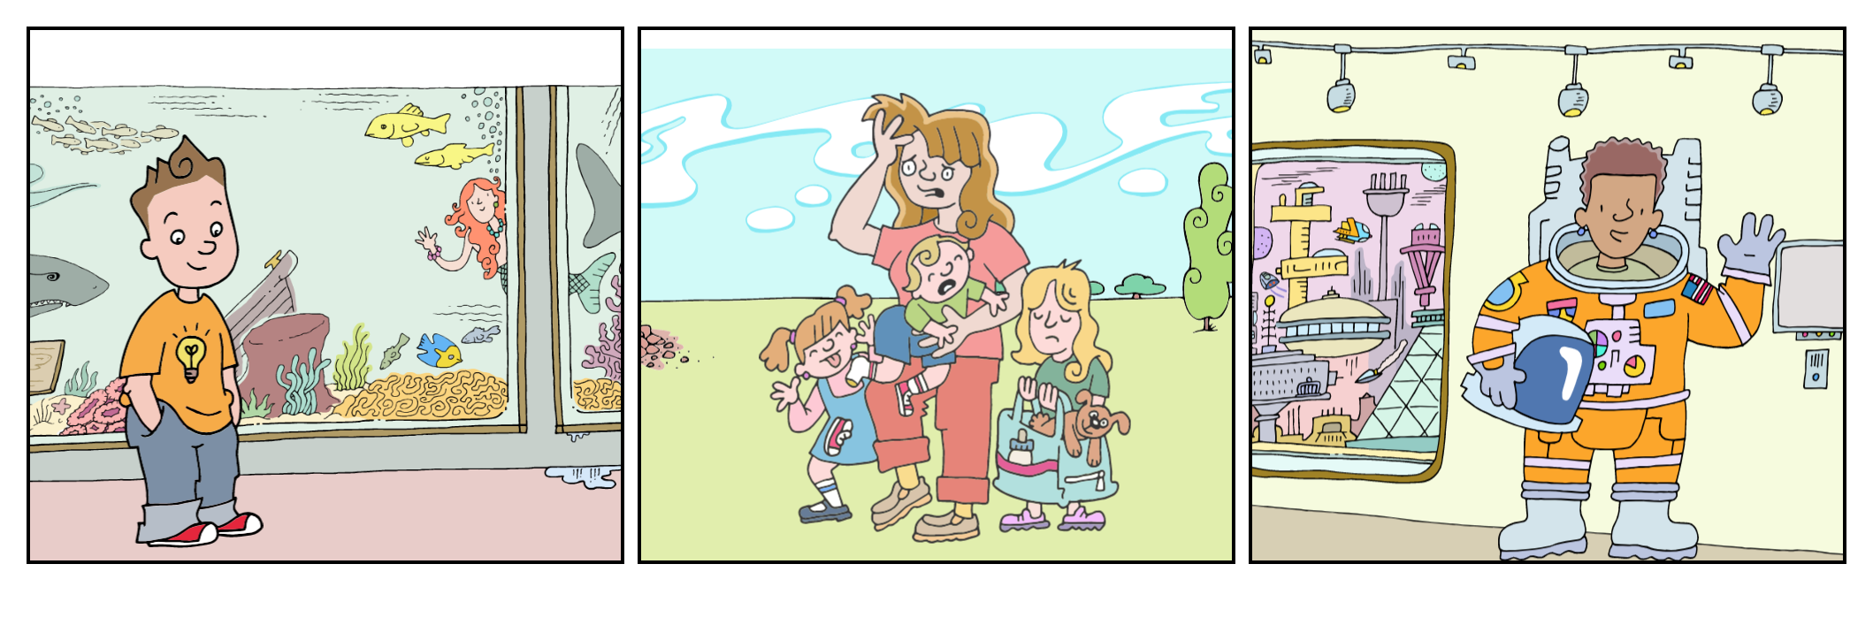
Create an autobiographical comix
Talk about yourself and your families

Slide 5
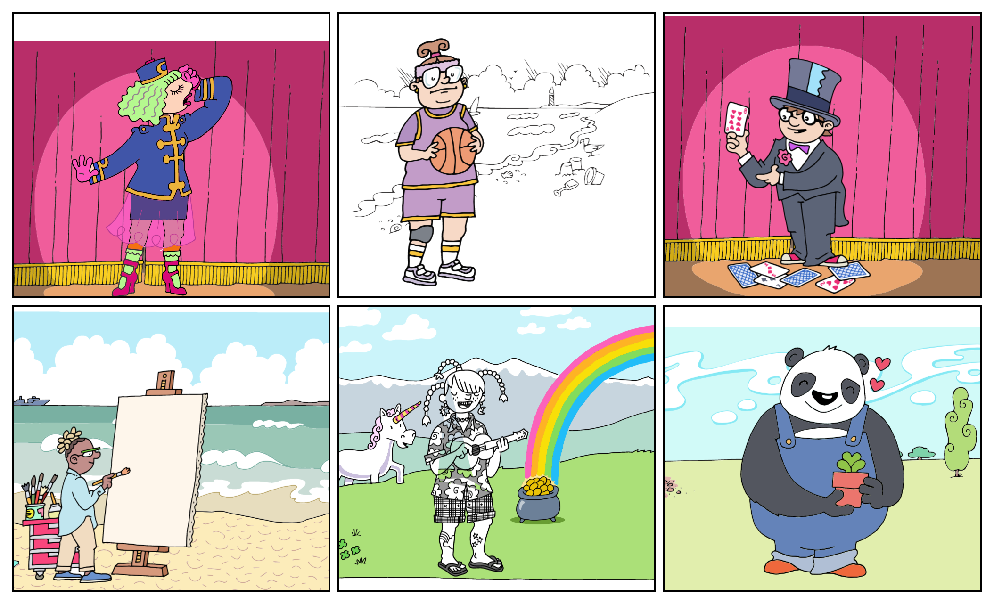
Basketball player
Gardener
Guitarist
Painter
Magician
Actress

