Slide 1
Word Clouds
Made by Kudinova Oxana
18ИА-о-21/2

Slide 2
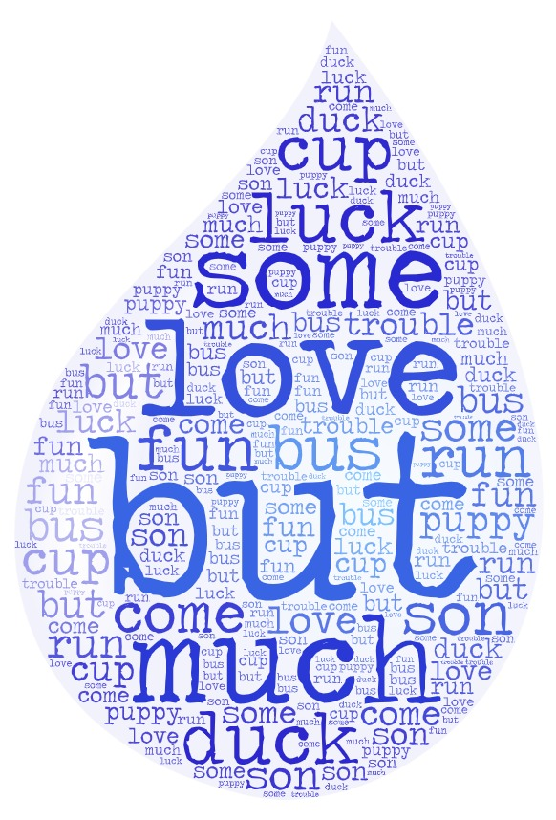
What these words have in common?
Make sentences with the words

Slide 3
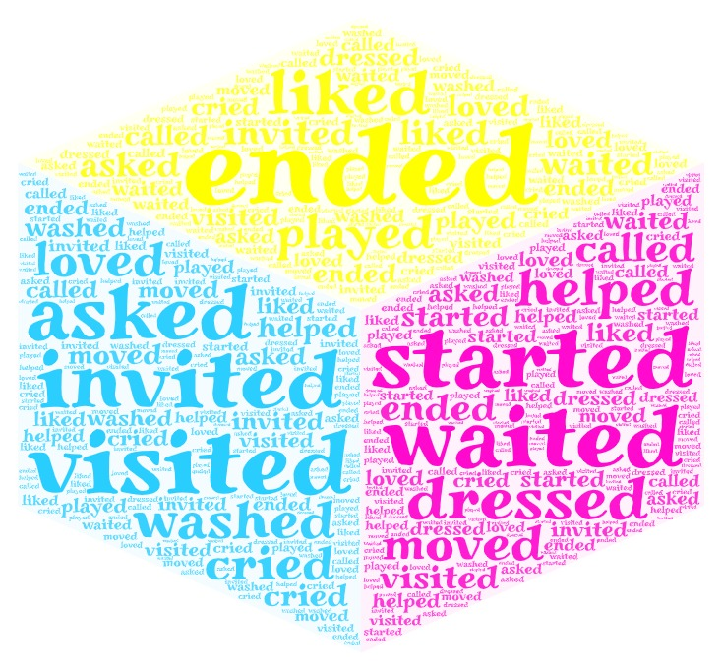
Divide these words into two groups
[ɪd] [d] [t]

Slide 4

Complete the sentences
He _____ __ when he remembered that he hadn't locked the door.
Ben asked the taxi driver to _____ __ the radio.
Can you _____ __ the volume, please? I can't hear a thing!
If you don't take care of your garden, it will _____ __ a jungle!
Please _____ __ the TV.
Can we _____ __ the air conditioner, please?
She _____ __ to be a very understanding person.
Don’t _____ __ the page till I read it down

Slide 5
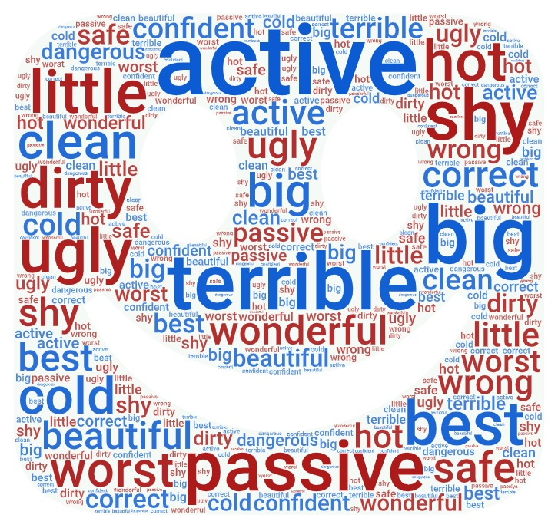
Antonyms

Slide 6

The Present Simple Tense
The Past Simple Tense
Make sentences with the verbs

Slide 7
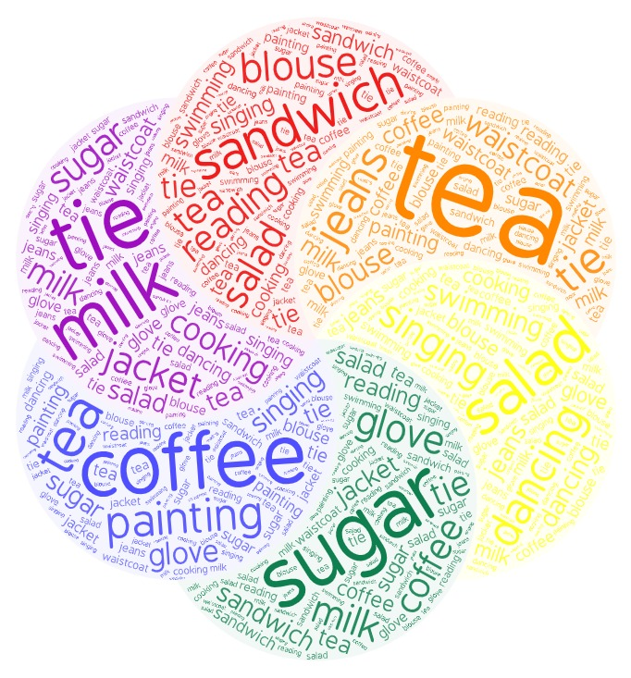
Food
Clothes
Hobbies

Slide 8

Восстановите порядок слов в предложении
Какое время использовано в этом предложении?
Поставьте вопросы к предложению
Составьте свои предложения

Slide 9
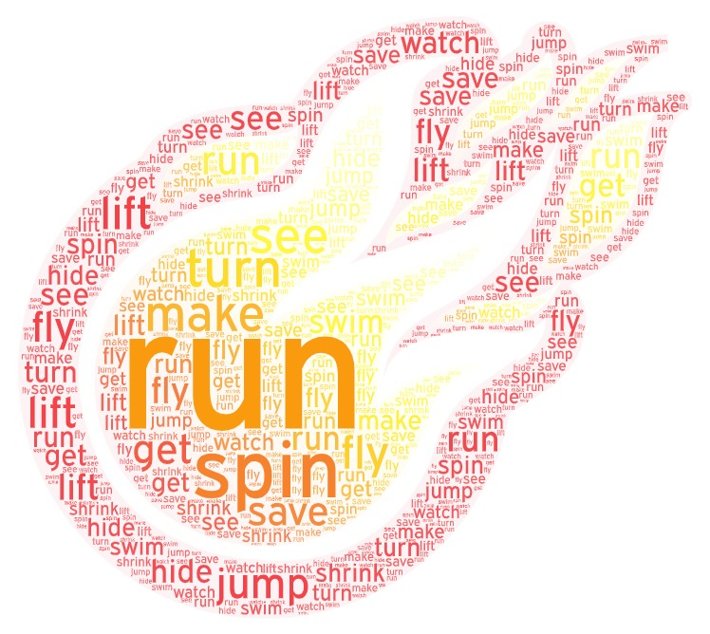
He can ___ faster than a train
She can ___ around and ___ it rain
He can ___ higher than a tree
She can ___ invisible and get in free!
She’s amazingly tall
He can ___ through walls
She can ___ into space
They can ___ television in someone else’s place!
We’re amazing superheroes and we’ve all got superpowers
We’re amazing superheroes and we’ve all got superpowers
We’re here to ___ the world.
He can ___ underwater for an hour
She can ___ and ___ inside a flower
He can ___ four elephants at one time
They all help us out by fighting crime.
We’re amazing superheroes and we’ve all got superpowers
We’re amazing superheroes and we’ve all got superpowers
We’re here to ___ the world.

Slide 10
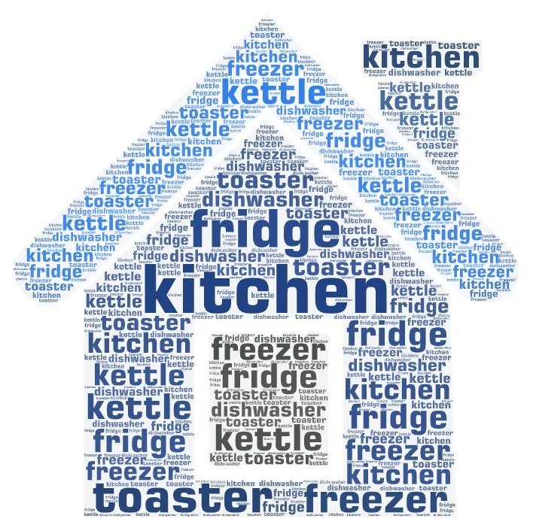
Complete the sentences
The place where we make and eat our meals. It is__
We keep milk, eggs, cheese and vegetables in the__
The __ keeps things frozen.
You put the bread in the ____, and it turns into toast.
We boil water to make tea in the ____.
Sometimes we put the dishes into the ____, and the it washes the dishes.

Slide 11

Write a short-story using these words

Slide 12
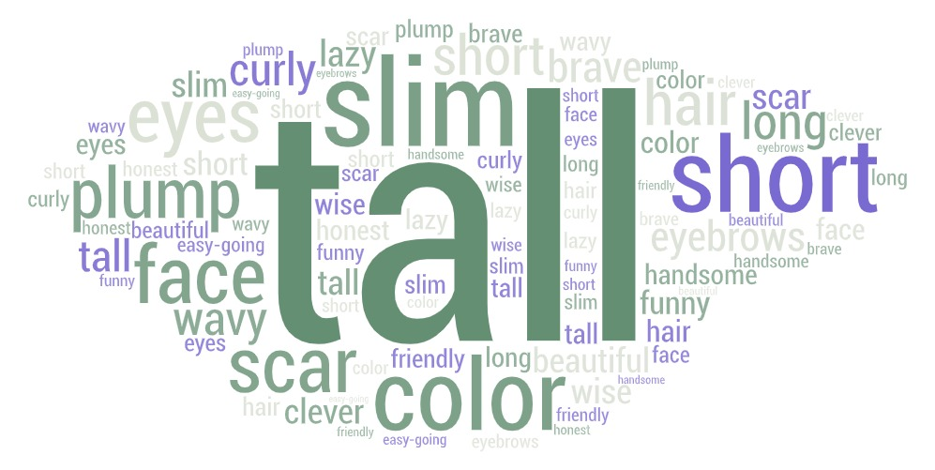
How would you describe your friend or yourself?

Slide 13
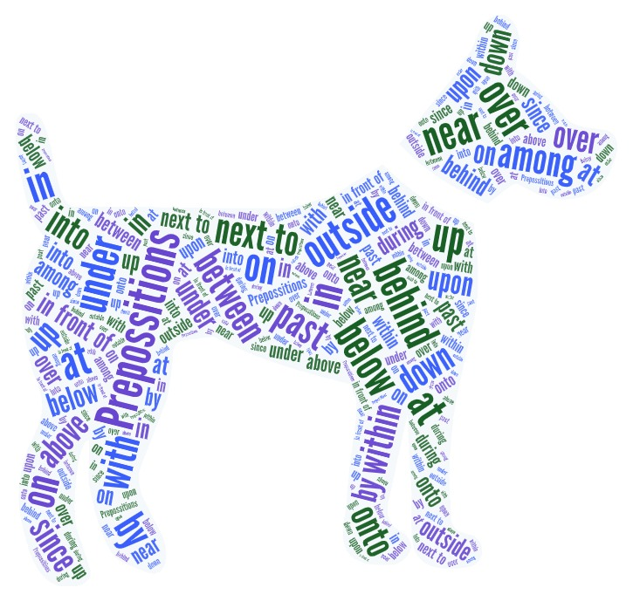
Where is the dog?

